Slide 1
COMPUTER NETWORKS
Chapter 3 The Data Link Layer

Slide 2
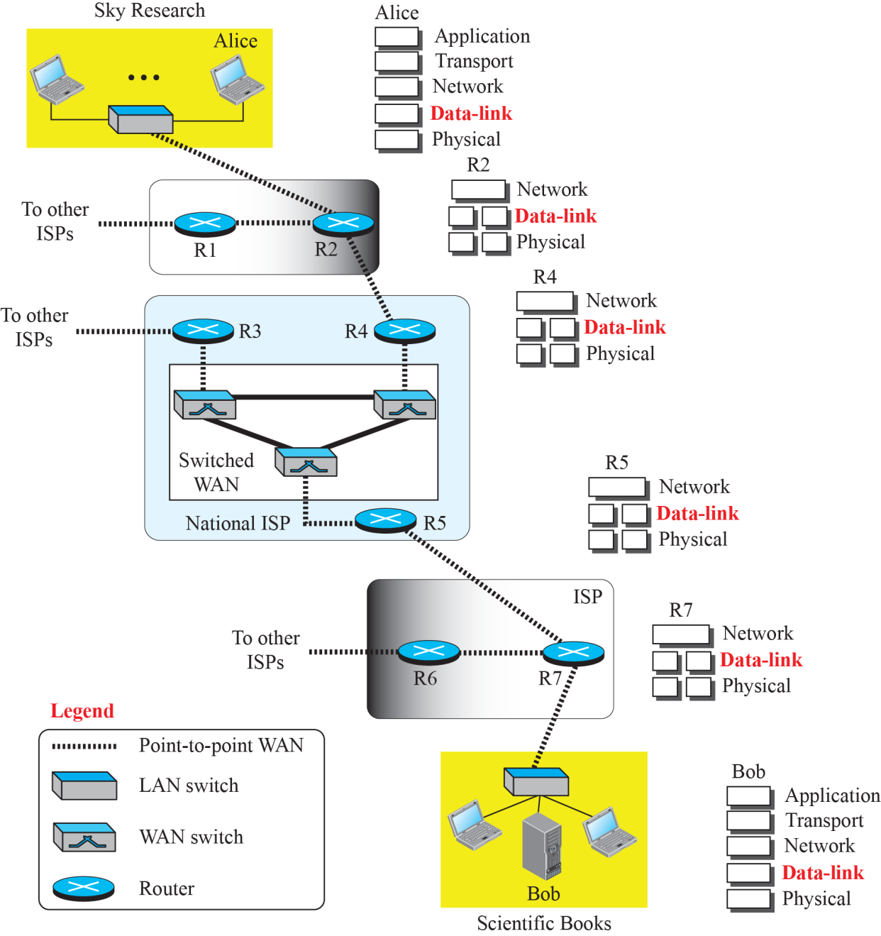
Responsible for delivering frames of information over a single link
Handles transmission errors and regulates the flow of data

Slide 3
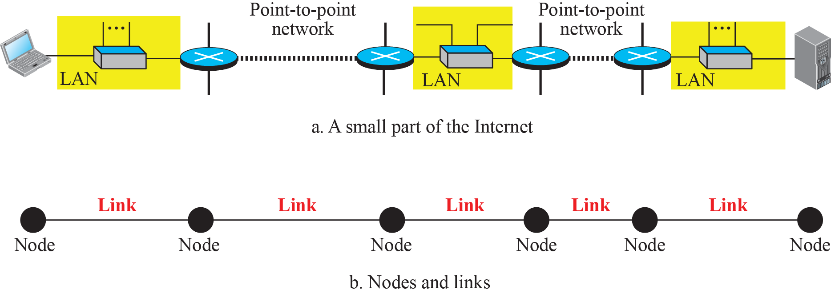
Nodes and Links
A data unit from one point in the Internet needs to pass through many networks (LANs and WANs) to reach another point. Theses LANs and WANs are connected by routers.
It is customary to refer to the two end hosts and the routers as nodes and the networks in between as links.

Slide 4
Two Categories of Links
A point-to-point link uses the whole capacity of the medium.
dedicated to the two devices
E.g., when two friends use the traditional home phones to chat, they are using a point-to-point link;
A broadcast link uses only part of the capacity of the link.
shared between several pairs of devices.
E.g., when the same two friends use their cellular phones, they are using a broadcast link (the air is shared among many cell phone users).

Slide 5
Two Sublayers of the Data Link Layer
Data Link Control (DLC) sublayer deals with all issues common to both point-to-point and broadcast links.
Media Access Control (MAC) sublayer deals only with issues specific to broadcast links.

Slide 6
The Data Link Layer Chapter 3
Data Link Layer Design Issues
Error Detection and Correction
Elementary Data Link Protocols
Improving Efficiency
Data Link Protocols in Practice
Summary

Slide 7
Data Link Layer Design Issues (1 of 2)
Network layer services
Framing
Error control
Flow control

Slide 8
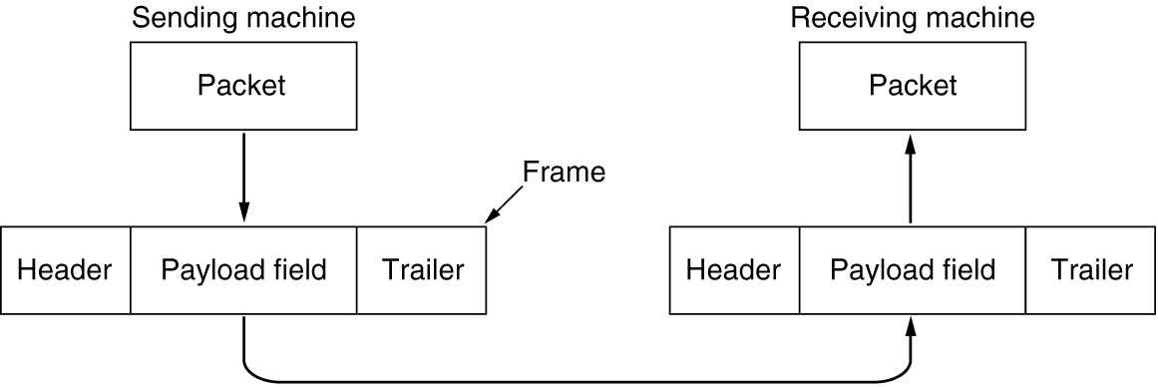
Data Link Layer Design Issues (2 of 2)
Link layer accepts packets from the network layer, and encapsulates them into frames that it sends using the physical layer;
reception is the opposite process
Relationship between packets and frames
Reason for encapsulation and decapsulation:
- the link-layer addresses are normally different
- each link may be using a different protocol with a different frame format.
Notes:
Assume a person needs to travel from her home to her friend’s home in another city.
The traveller can use three transportation tools. She can take a taxi to go to the train station in her own city, then travel on the train from her own city to the city where her friend lives, and finally reach her friend’s home using another taxi. Here we have a source node, a destination node, and two intermediate nodes.
The traveller needs to get into the taxi at the source node, get out of the taxi and get into the train at the first intermediate node (train station in the city where she lives), get out of the train and get into another taxi at the second intermediate node (train station in the city where her friend lives), and finally get out of the taxi when she arrives at her destination.
A kind of encapsulation occurs at the source node, encapsulation and decapsulation occur at the intermediate nodes, and decapsulation occurs at the destination node.
Our traveller is the same, but she uses three transporting tools to reach the destination.

Slide 9
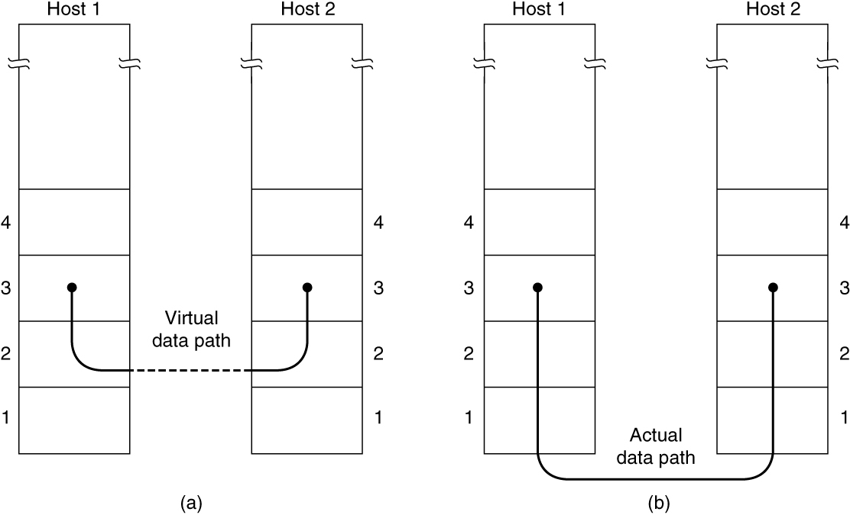
Services Provided to The Network Layer (1 of 2)
(a) Virtual communication. (b) Actual communication.

Slide 10
Services Provided to The Network Layer (2 of 2)
Actual services vary from protocol to protocol
Three possible services
Unacknowledged connectionless service
Frame is sent with no connection / error recovery
Ethernet is example
Acknowledged connectionless service
Frame is sent with retransmissions if needed
Example is 802.11
Acknowledged connection-oriented service
Connection is set up; rare

Slide 11
Framing
Framing methods
Byte count
Flag bytes with byte stuffing
Flag bits with bit stuffing
Physical layer coding violations
Use non-data symbol to indicate frame
Framing: breaking up the bit stream into frames

Slide 12
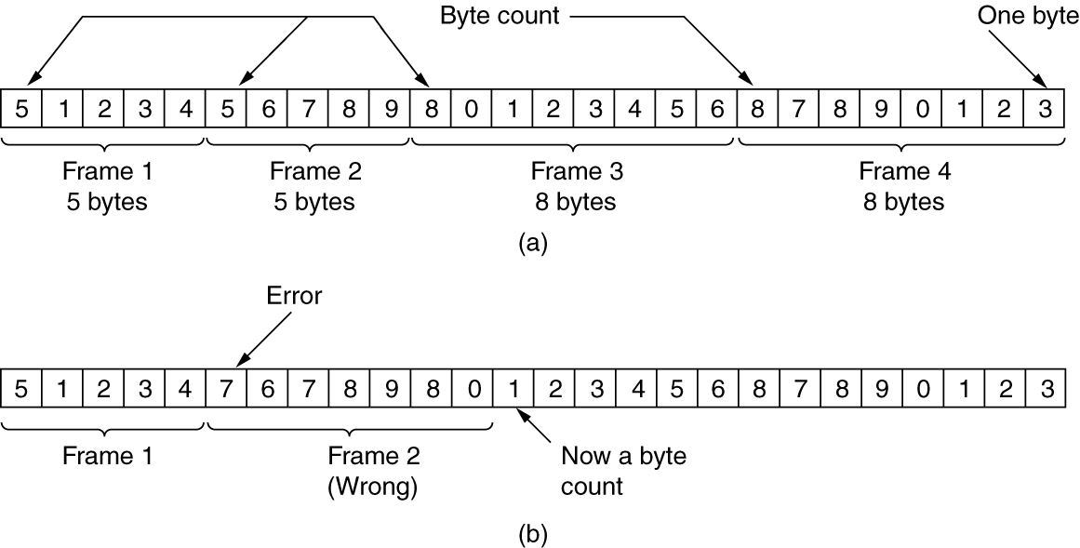
Framing: Byte count
Frame begins with a count of the number of bytes in it
Simple, but difficult to resynchronize after an error
A byte stream. (a) Without errors. (b) With one error.

Slide 13
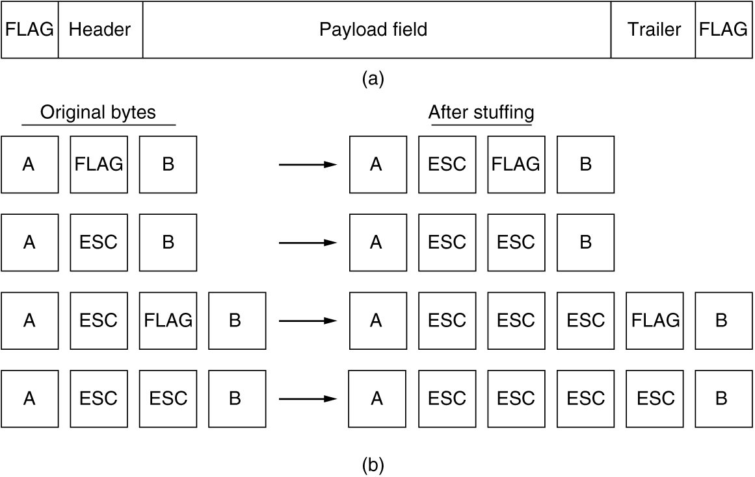
Framing: Flag bytes with byte stuffing
Special flag bytes delimit frames; occurrences of flags in the data must be stuffed (escaped)
Longer, but easy to resynchronize after error
依赖于8位字符
Need to escape extra ESCAPE bytes too!
(a) A frame delimited by flag bytes. (b) Four examples of byte sequences before and after byte stuffing.

Slide 14
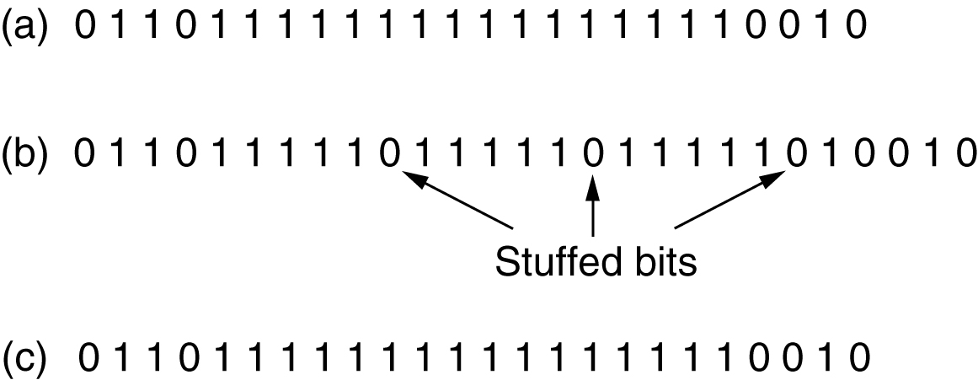
Framing: Flag bytes with bit stuffing
Stuffing done at the bit level
Frame flag（01111110） has six consecutive 1s (not shown)
On transmit, after five 1s in the data, a 0 is added
On receive, a 0 after five 1s is deleted
Bit stuffing. (a) The original data. (b) The data as they appear on the line. (c) The data as they are stored in the receiver’s memory after destuffing.

Slide 15
Framing – Physical layer coding violations
物理层编码违例法，以曼彻斯特编码为例：
数据比特‘1’编码成“高-低”电平对，数据比特‘0’编码成“低-高”电平对。
“高-高”电平对和“低-低”电平对是违例编码。可以利用这些违规编码来定界帧的起始和终止。

Slide 16
Error Control
Ensuring all frames are eventually delivered:
To the network layer at the destination
In the proper order
Ensures reliable, connection-oriented service
Requires acknowledgement frames and timers
Error detection
Acknowledgement
Retransmission

Slide 17
Flow Control
Controlling the sending of transmission frames at a faster pace than they can be accepted
Feedback-based flow control
Receiver sends back information to the sender giving it permission to send more data
Or receiver tells the sender how the receiver is doing
Rate-based flow control
Protocol has a built-in mechanism
Mechanism limits the rate at which senders may transmit data
No feedback from the receiver is necessary
Flow control is a topic in the Link and Transport layers.
Notes:
Rare in the Link layer as NICs run at “wire speed”
Receiver can take data as fast as it can be sent

Slide 18
The Data Link Layer Chapter 3
Data Link Layer Design Issues
Error Detection and Correction
Elementary Data Link Protocols
Improving Efficiency
Data Link Protocols in Practice
Summary

Slide 19
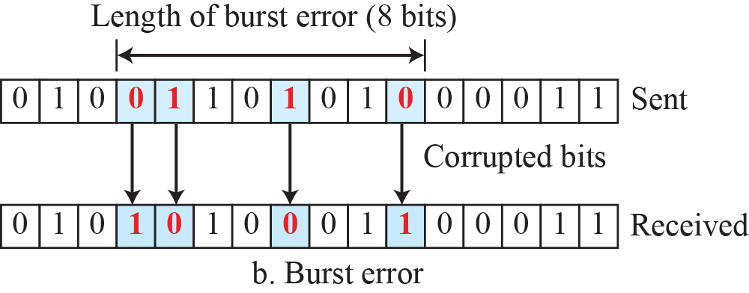
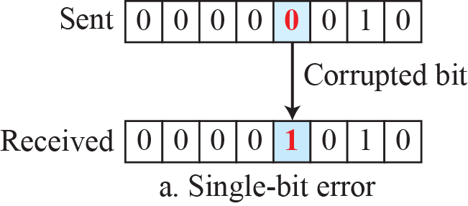
Type of Errors
Single-bit error means that only 1 bit of a given data unit (such as a byte, character, or packet) is changed from 1 to 0 or from 0 to 1.
Burst error means that 2 or more bits in the data unit have changed from 1 to 0 or from 0 to 1.

Slide 20
Error Detection and Correction
Error codes add structured redundancy to data so errors can be either detected, or corrected.
The correction of errors is more difficult than the detection.
In error detection, we are only looking to see if any error has occurred. The answer is a simple yes or no. We are not even interested in the number of corrupted bits. A single-bit error is the same for us as a burst error.
In error correction, we need to know the exact number of bits that are corrupted and, more importantly, their location in the message.

Slide 21
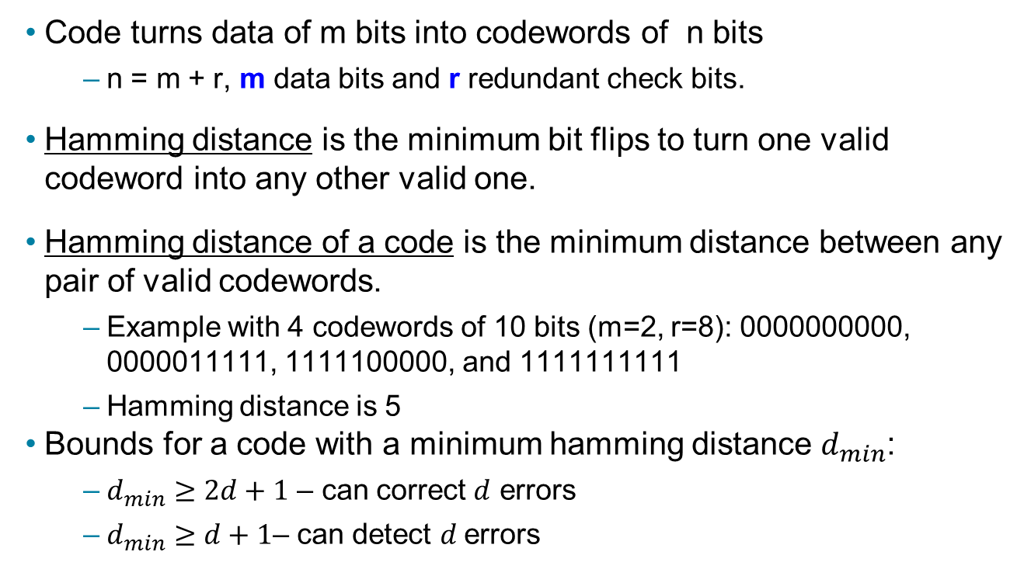
Error Bounds -- Hamming distance
Code turns data of m bits into codewords of n bits
n = m + r, m data bits and r redundant check bits.
Hamming distance is the minimum bit flips to turn one valid codeword into any other valid one.
Hamming distance of a code is the minimum distance between any pair of valid codewords.
Example with 4 codewords of 10 bits (m=2, r=8): 0000000000, 0000011111, 1111100000, and 1111111111
Hamming distance is 5
Bounds for a code with a minimum hamming distance $d_{min}$:
$d_{min}≥2d+1$ – can correct $d$ errors
$d_{min}≥d+1$– can detect $d$errors

Slide 22
Explanation of Error Bounds
Errors are detected by receiving invalid codewords.
从一个正确的码字出发任意走d步（也就是最多有d位出错）都不会到达另外一个正确的码字，但是走d+1步就有可能到达另外一个正确码字，也就是说错了d+1个位以后被当成无错的码字接受。
Errors are corrected by mapping a received invalid codeword to the nearest valid codeword, i.e., the one that can be reached with the fewest bit flips.
从一个正确的码字出发任意走d步都还是离这个码最近，离另外一个正确的码字至少有d+1步距离，因此纠错时只要知道错误不超过d位就能够将其对应纠正到最近的正确码字。
Notes:
If there are more than d bit flips, then the received codeword may be closer to another valid codeword than the codeword that was sent. For example, sending 0000000000 with 2 flips might give 1100000000 which is closest to 0000000000, correcting the error. But with 3 flips 1110000000 might be received, which is closest to 1111100000, which is still an error.

Slide 23
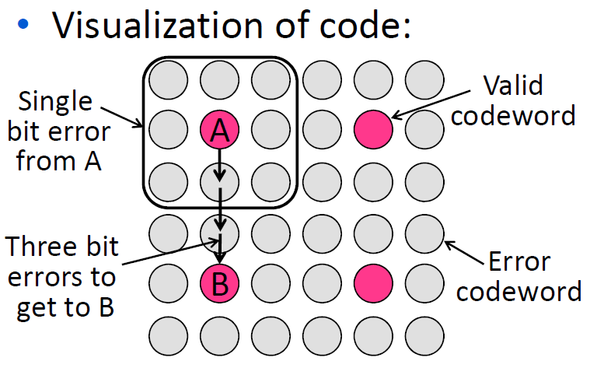
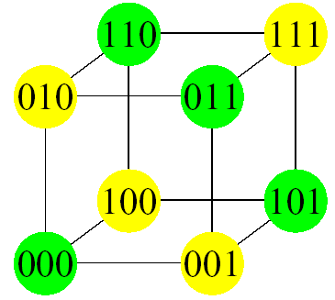
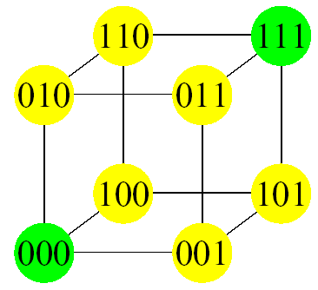
HDistance=2
HDistance=3

Slide 24
Exercises
Find the minimum Hamming distance of the following coding scheme:
00000, 01011, 10101, 11110
d_{min} in this case is 3
This code can detect up to two errors,
and it can correct up to one error.

Slide 25
Linear Block Codes
Almost all block codes used today belong to a subset called linear block codes.
A linear block code is a code in which the result of XORing any codeword with any other codeword is a valid codeword.
E.g., the code schemes on the previous slides
00000, 01011, 10101, 11110
00000
01011
-----
01011
01011
10101
-----
01011
10101
11110
-----
01011
00000
11110
-----
11110
00000
10101
-----
10101
01011
11110
-----
10101

Slide 26
Error Detection and Correction
Error-correcting codes
Referred to as FEC (Forward Error Correction)
Include enough redundant information to enable the receiver to deduce what the transmitted data must have been
Error-detecting codes
Include only enough redundancy to allow the receiver to deduce that an error has occurred (but not which error) and have it request a retransmission
Key consideration is the type of errors likely to occur

Slide 27
Error-Correcting Codes
Hamming codes
Binary convolutional codes
Reed-Solomon codes
Low-Density Parity Check codes

Slide 28
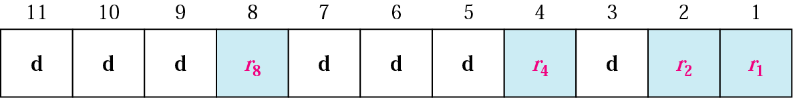
Hamming Codes
Hamming codes provide for FEC using a “Block Parity”
Allows correction of single bit errors
This is accomplished by using more than one parity bit
Each computed on different combination of bits in the data
Positions of Redundancy Bits

Slide 29
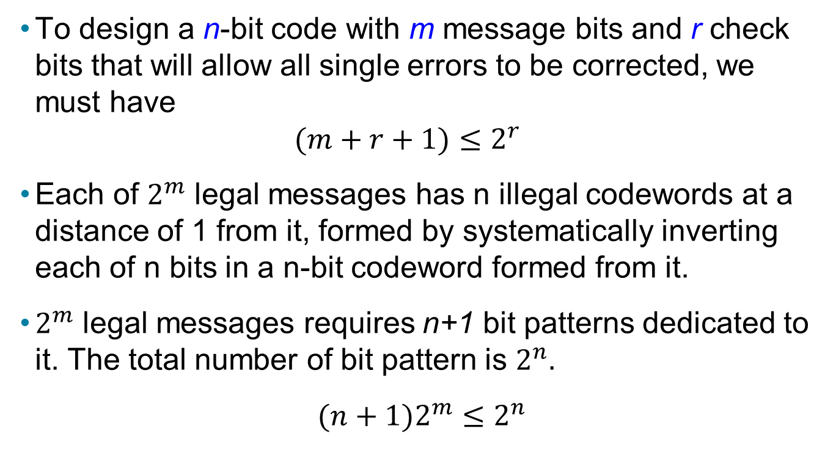
Single Error Correction
To design a n-bit code with m message bits and r check bits that will allow all single errors to be corrected, we must have
$$(m+r+1)≤2^{r}$$
Each of $2^{m}$ legal messages has n illegal codewords at a distance of 1 from it, formed by systematically inverting each of n bits in a n-bit codeword formed from it.
$2^{m}$ legal messages requires n+1 bit patterns dedicated to it. The total number of bit pattern is $2^{n}.$
$(n+1)2^{m}≤2^{n}$

Slide 30
Data and redundancy bits of Hamming Codes
Number of data bits m | Number of redundancy bits r | Total bits m + r
1 | 2 | 3
2 | 3 | 5
3 | 3 | 6
4 | 3 | 7
5 | 4 | 9
6 | 4 | 10
7 | 4 | 11

Slide 31
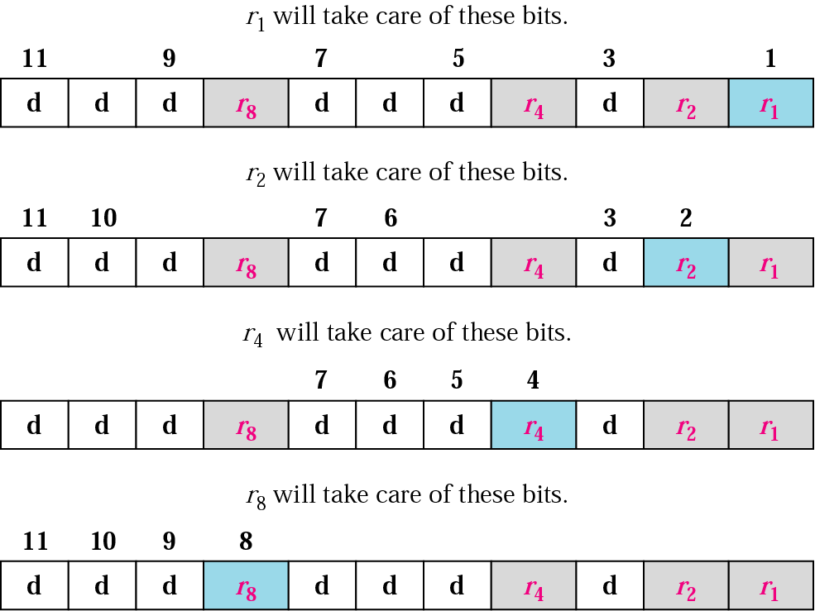
Redundancy Bits Calculation
1
2
3
4
5
6
7
8
9
10
11
0001
0010
0011
0100
0101
0110
0111
1000
1001
1010
1011
r₈r₄r₂r₁

Slide 32
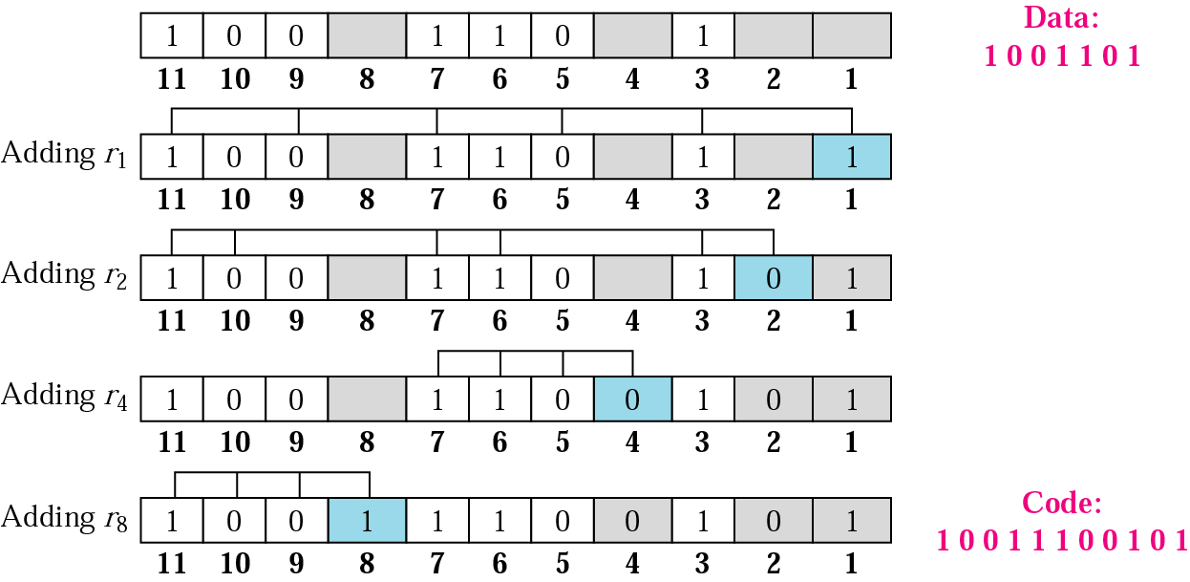
Example

Slide 33
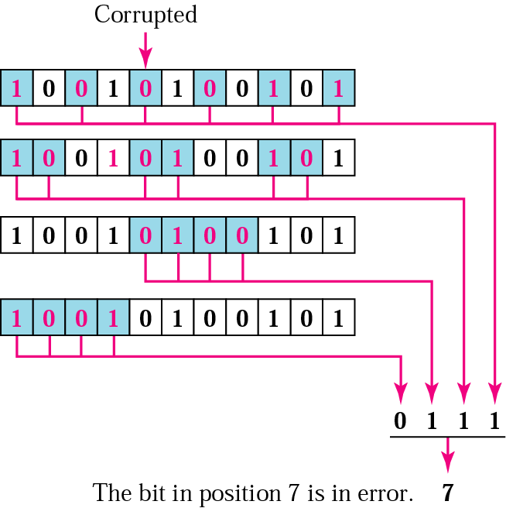
Error Correction using Hamming Code

Slide 34
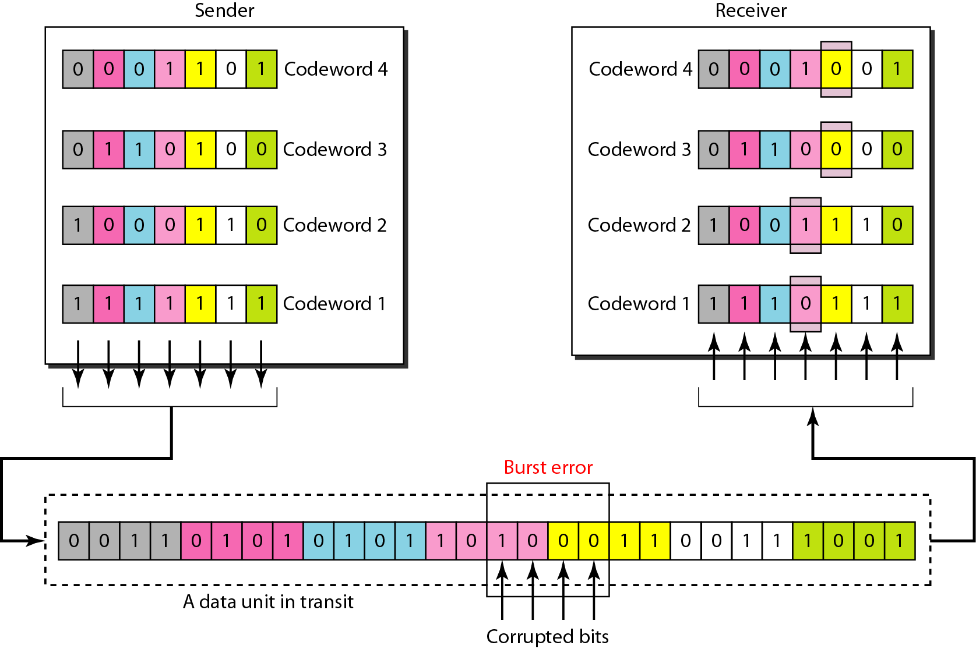
Burst error correction using Hamming code

Slide 35
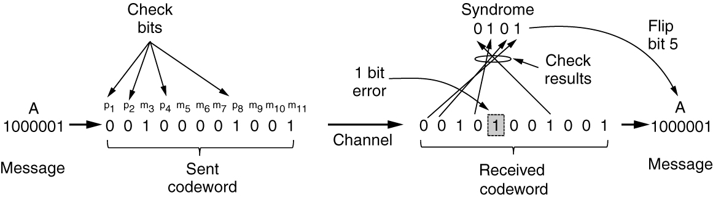
Summary of Hamming code
Hamming code gives a simple way to add check bits and correct up to a single bit error:
Check bits are parity over subsets of the codeword
Recomputing the parity sums (syndrome) gives the position of the error to flip, or 0 if there is no error
Example of an (11, 7) Hamming code correcting a single-bit error

Slide 36
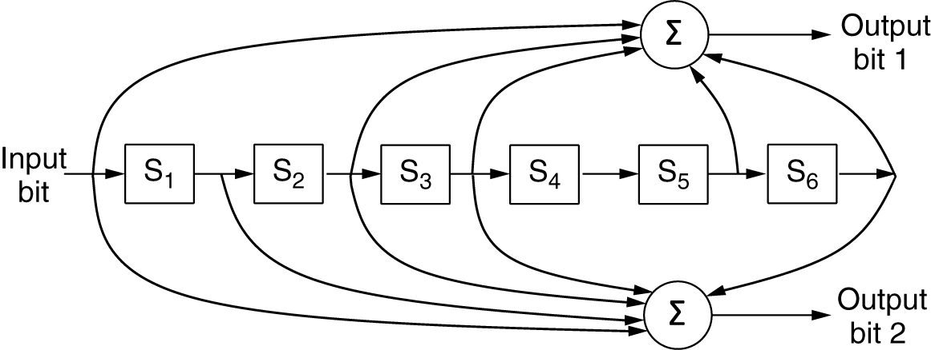
Convolutional codes
Operates on a stream of bits, keeping internal state
Output stream is a function of all preceding input bits
Bits are decoded with the Viterbi algorithm
Widely used in GSM mobile phone system, satellite communications
… 1 1 1
…
0 1 1
1 0 1
The NASA binary convolutional code used in 802.11
Since 1 input bit produces 2 output bits, the code rate is 1/2.
It takes seven shifts to flush an input completely so that it does not affect the output. The constraint length of this code is thus k = 7.

Slide 37
Reed-Solomon and Low-Density Parity Check codes
Reed-Solomon codes
Linear block codes. Often systematic
Codes are based on the fact that every n degree polynomial is uniquely determined by n + 1 points
DSL, data over cable, satellite communications, CDs, DVDs, and Blu-ray discs
LDPC (Low-Density Parity Check) codes
Linear block codes
Each output bit is formed from only a fraction of the input bits
Practical for large block sizes
Have excellent error-correction abilities that outperform many other codes
digital video broadcasting, 10Gbps Ethernet, power-line network, latest version of 802.11

Slide 38
Error-Detecting Codes
Linear, systematic block codes
Parity
Checksums
Cyclic Redundancy Checks (CRCs)

Slide 39
Parity (1)
Parity bit is added as the modulo 2 sum of data bits
Equivalent to XOR; this is even parity
Ex: 1110000 → 11100001
Detection checks if the sum is wrong (an error)
Simple way to detect an odd number of errors
Ex: 1 error, 11100101; detected, sum is wrong
Ex: 3 errors, 11011001; detected sum is wrong
Ex: 2 errors, 11101101; not detected, sum is right!
Error can also be in the parity bit itself
Random errors are detected with probability ½

Slide 40
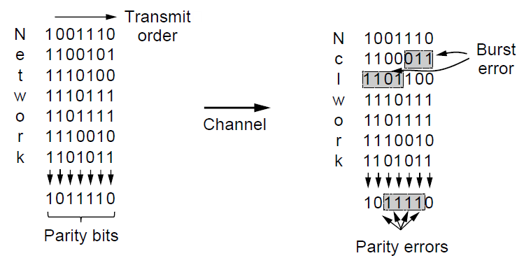
Parity (2)
Interleaving of N parity bits detects burst errors up to N
Each parity sum is made over non-adjacent bits
An even burst of up to N errors will not cause it to fail

Slide 41
Checksums
Checksum is an error-detecting technique that can be applied to a message of any length.
Checksum treats data as N-bit words and adds N check bits that are the modulo 2^{N} sum of the words
Ex: Internet 16-bit 1s complement checksum
Properties:
Improved error detection over parity bits
Detects bursts up to N errors
Vulnerable to systematic errors, e.g., added zeros

Slide 42
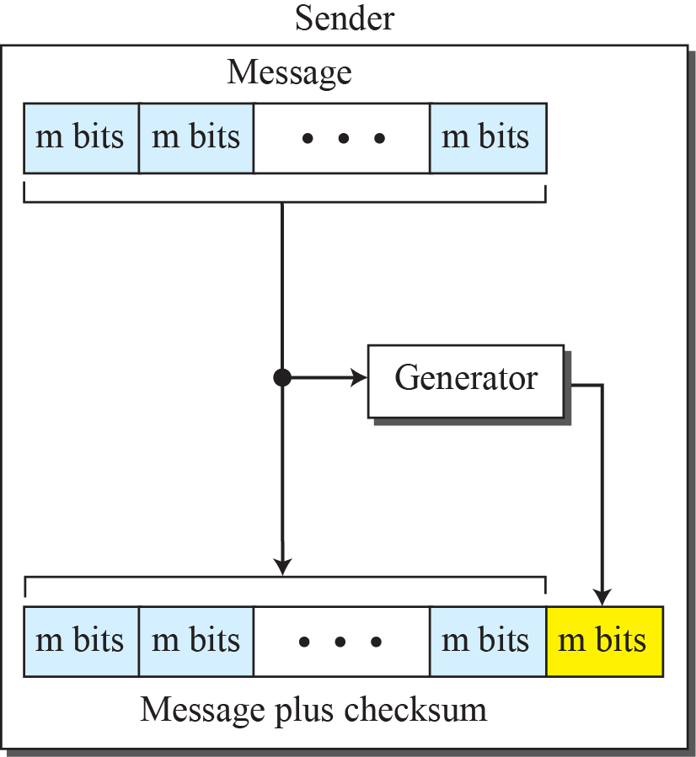
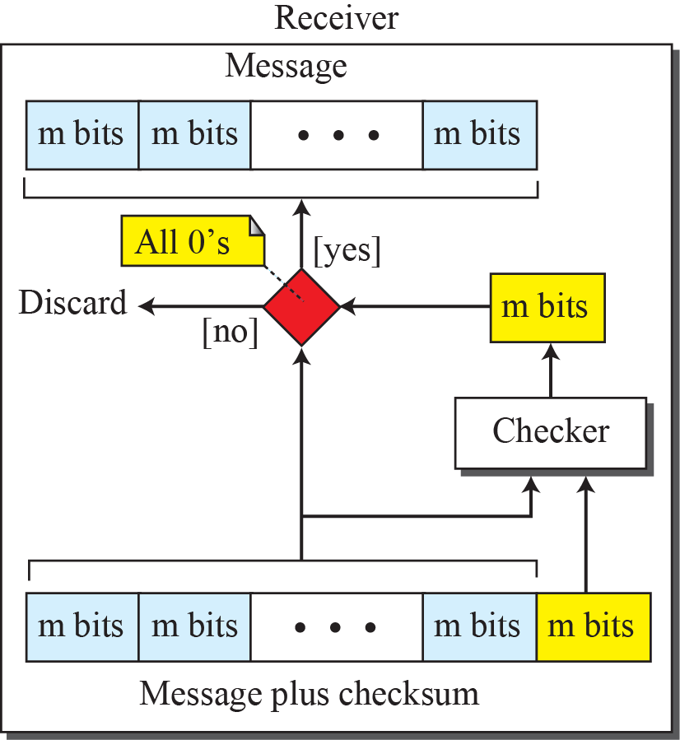
Checksum

Slide 43
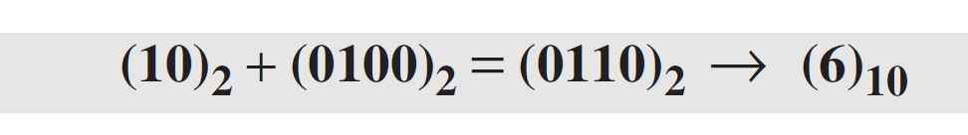
Checksum Example
Suppose the message is a list of five 4-bit numbers that we want to send to a destination. In addition to sending these numbers, we send the sum of the numbers.
For example, if the set of numbers is (7, 11, 12, 0, 6), we send (7, 11, 12, 0, 6, 36), where 36 is the sum of the original numbers.
The decimal number 36 in binary is (100100)2. To change it to a 4-bit number we add the extra leftmost bit to the right four bits as shown below.

Slide 44
Checksum Example (cont.)
The sender adds all five numbers in one’s complement to get the sum = 6. The sender then complements the result to get the checksum = 9, which is 15 − 6.
Note that 6 = (0110)2 and 9 = (1001)2; they are complements of each other.
The sender sends the five data numbers and the checksum (7, 11, 12, 0, 6, 9).
If there is no corruption in transmission, the receiver receives (7, 11, 12, 0, 6, 9) and adds them in one’s complement to get 15.

Slide 45
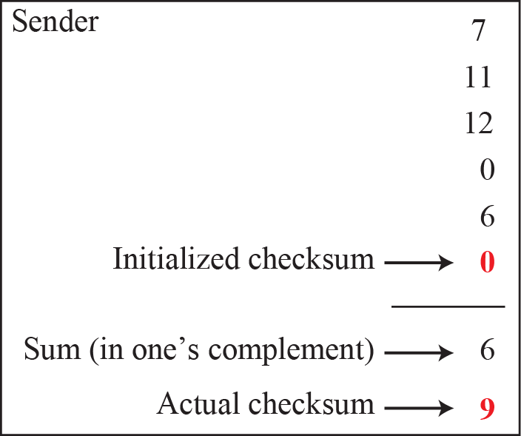
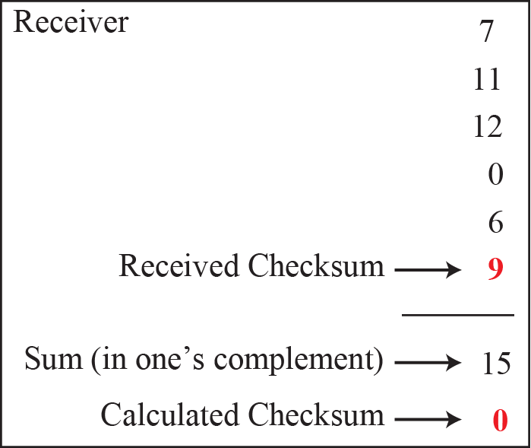
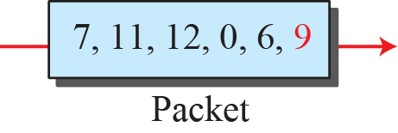
Calculation procedure of the previous example

Slide 46
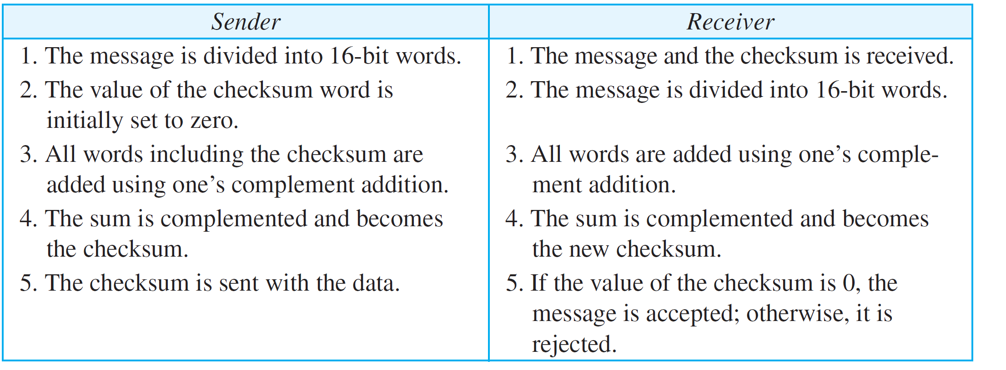
Procedure to calculate the traditional checksum

Slide 47
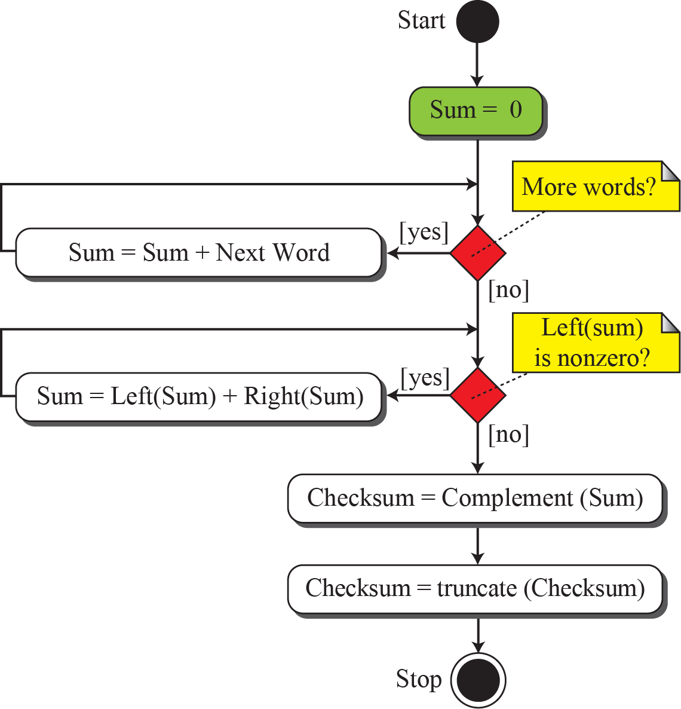
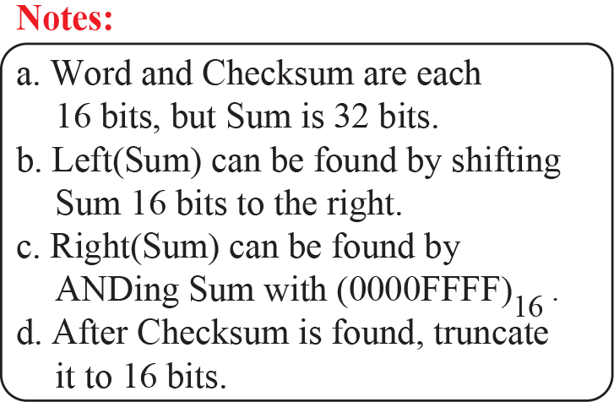
Algorithm to calculate the traditional checksum

Slide 48
Problems of the traditional checksum calculation
If two 16-bit items are transposed in transmission, the checksum cannot catch this error.
The reason is that the traditional checksum is not weighted: it treats each data item equally.
In other words, the order of data items is immaterial to the calculation.
Several approaches have been used to prevent this problem, such as Fletcher and Adler.
Notes:
Immaterial:无关紧要的

Slide 49
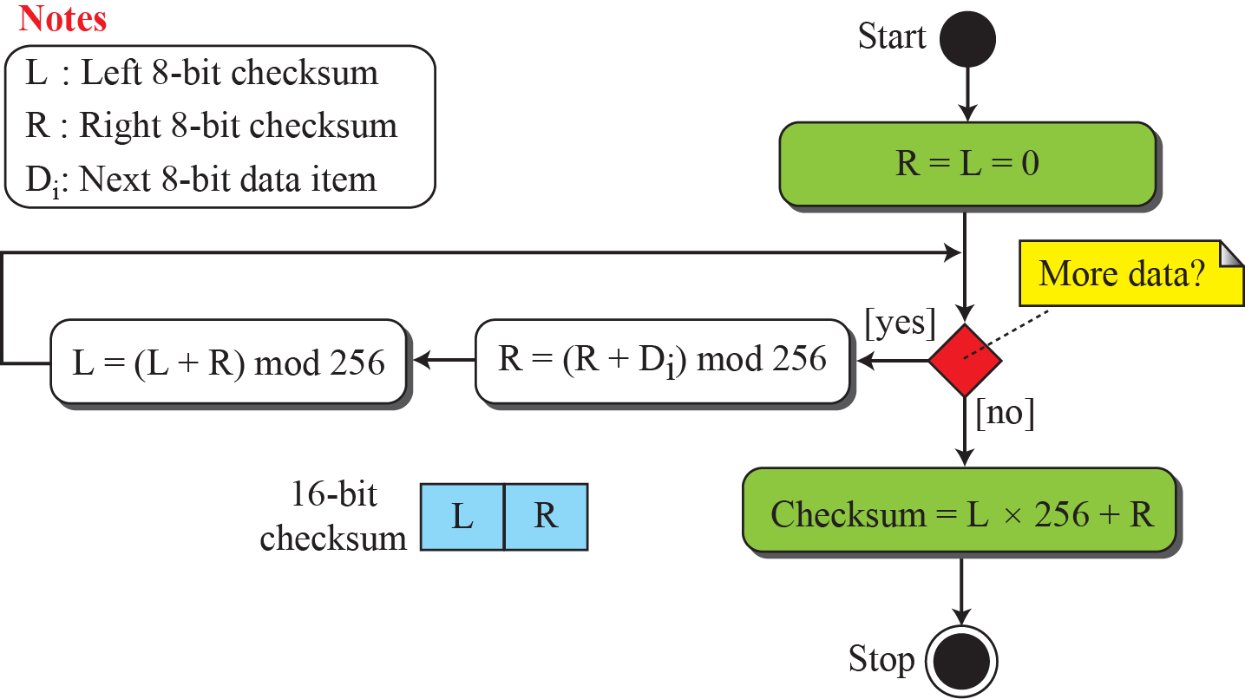
Algorithm to calculate an 8-bit Fletcher checksum
Weight each data item according to its position
The 8-bit Fletcher is calculated over data octets(bytes) and creates a 16-bit checksum
The calculation is done modulo 256.
Two accumulators: L and R

Slide 50
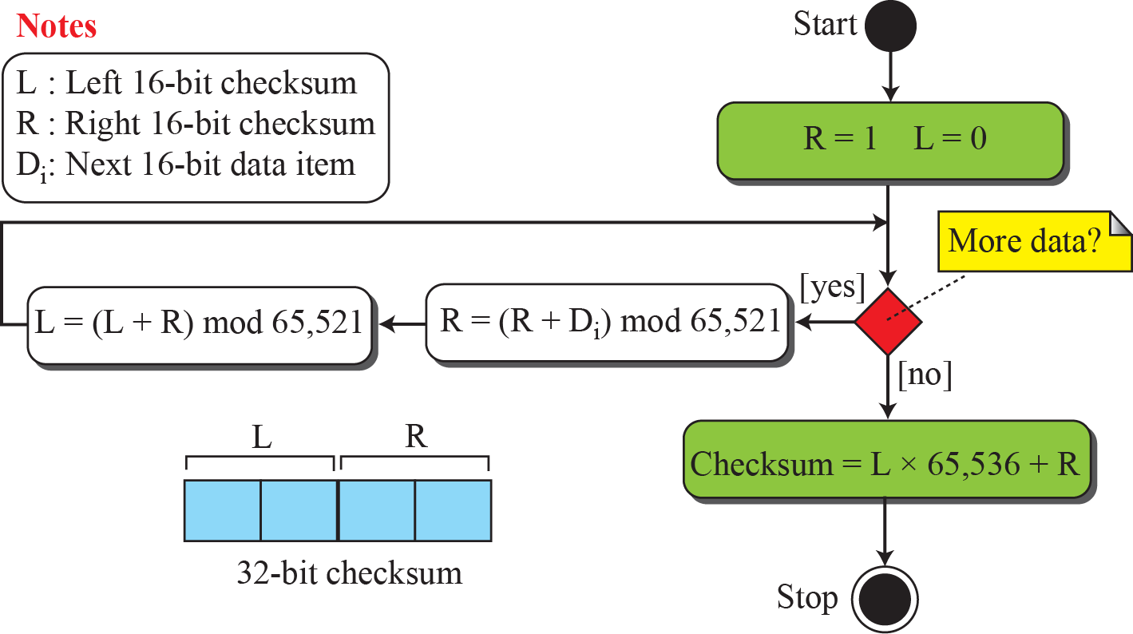
Algorithm to calculate an Adler checksum
Similar to the 16-bit Fletcher with three differences:
Calculation is done on single bytes instead of 2 bytes at a time.
The modulus is a prime number(65521) instead of 65536.
R is initialized to 1 instead of 0.
Notes:
旨在改进 Fletcher Checksum。Adler校验和使用质数作为模数，比如251（Fletcher 256）， 65521（Fletcher 65536）

Slide 51
Cyclic codes
Cyclic codes are special linear block codes with one extra property.
In a cyclic code, if a codeword is cyclically shifted (rotated), the result is another codeword.
For example, if 1011000 is a codeword and we cyclically left-shift, then 0110001 is also a codeword.
Cyclic Redundancy Check (CRC), which is used in networks such as LANs and WANs. It adds bits so that transmitted frame viewed as a polynomial is evenly divisible（整除） by a generator polynomial.

Slide 52
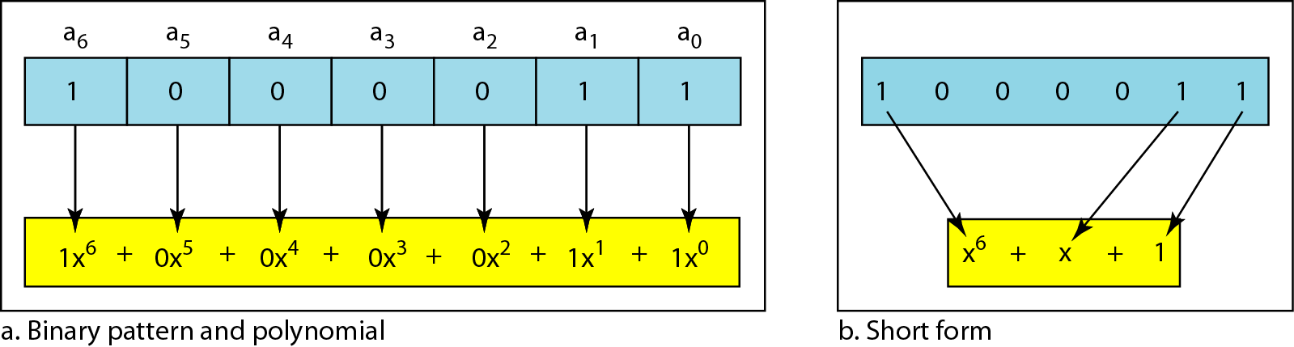
A polynomial to represent a binary word

Slide 53
CRC Calculation
校验码的生成过程：假设要发送的信息用多项式 C(x) 表示，将 C(x) 左移 R 位（可表示成 C(x) << R），这样 C(x) 的右边就会空出 R 位，这就是校验码的位置。用 C(x) << R除以 G(x) 得到的余数就是校验码。
G(x)： 表示 CRC 的生成多项式，是接收方和发送方的一个约定，由 CRC 规范给定。在整个传输过程中，这个二进制数始终保持不变。例如 CRC-CCITT 的生成多项式为 G(x) = x¹⁶ + x¹² + x⁵ + 1。
C(x)： 表示发送的原始数据的多项式。例如 C(x) = x⁵ + x³ + x² + x + 1 表示发送的数据为 101111
R(x)： 表示CRC 码的多项式。R(x) = (C(x) << R) % G(x)
T(x)： 表示发送的原始数据加上 CRC 码之后的多项式。T(x) = C(x) << R + R(x)
K：发送数据的长度。其等于 C(x) 中的最高次的幂 + 1。如上例子的 C(x) 中，K = 5 + 1 = 6
R： CRC 码 的长度。CRC校验码位数 = 生成多项式G(x)位数 - 1。
1101010110
商（CRC不用）
G(x)除数
110101
101000110100000
被除数C(x)<<R
01110
左移R位，补位0
原始数据C(x)
CRC码R(x)
实际需要发送的数据是101000110101110。需要注意的是，余数（R(x)）不足 R 位时，高位补 0！
Notes:
CRC分为以下几种标准：
CRC-12码
CRC-16码
CRC-CCITT码
CRC-32码
CCITT国际电报电话咨询委员会，是国际电信咨询机构，简称CCITT,总部设在瑞士日内瓦

Slide 54
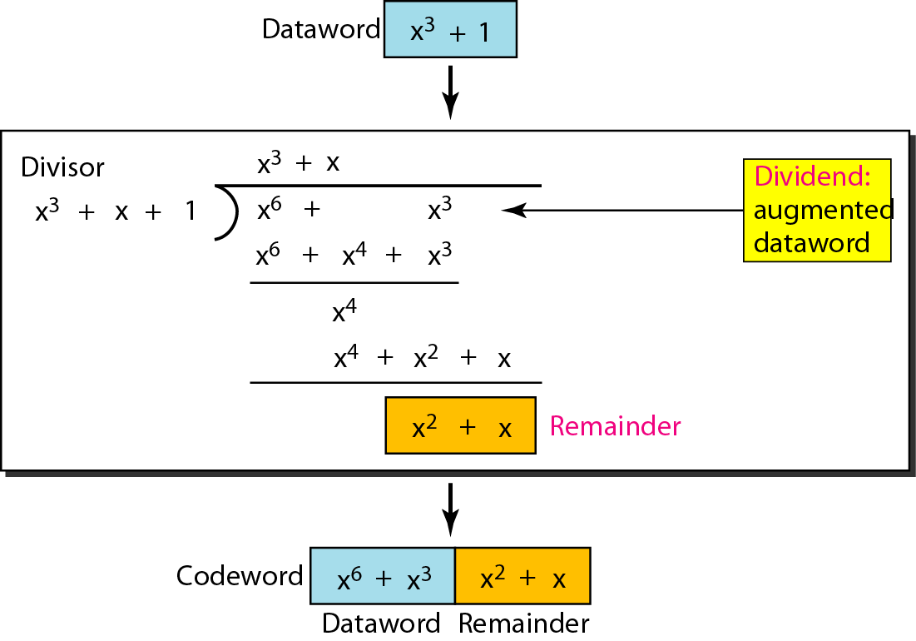
CRC division using polynomials

Slide 55
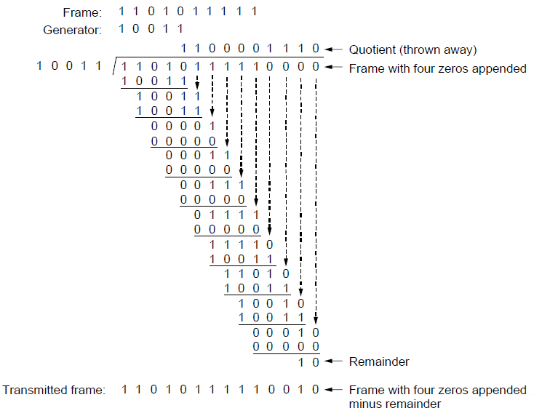
Example Calculation of the CRC
Start by adding 0s to frame and try dividing
Offset by any reminder to make it evenly divisible

Slide 56
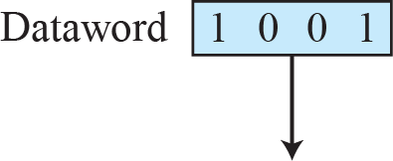
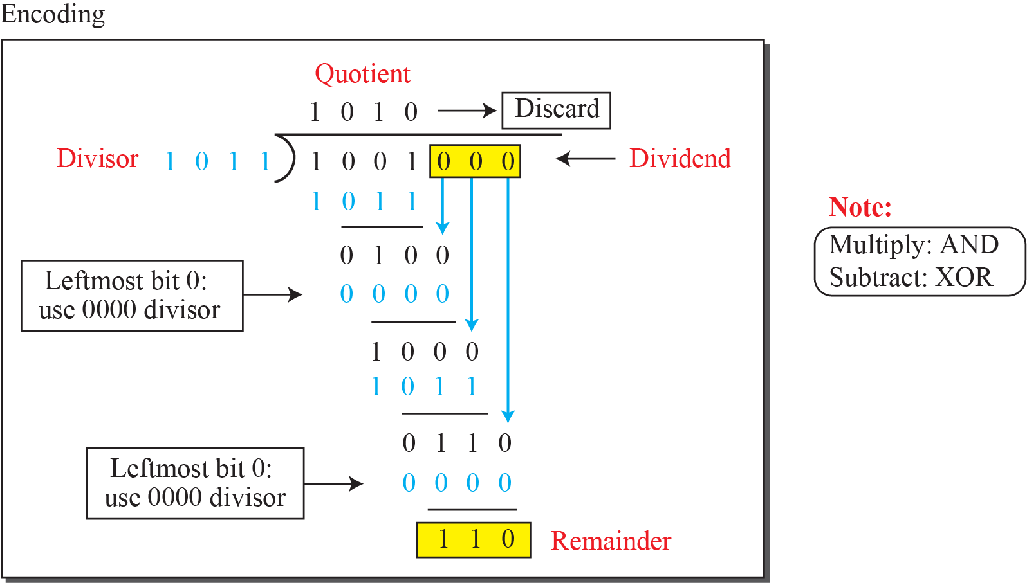
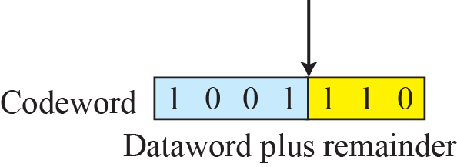
Division in CRC encoder

Slide 57
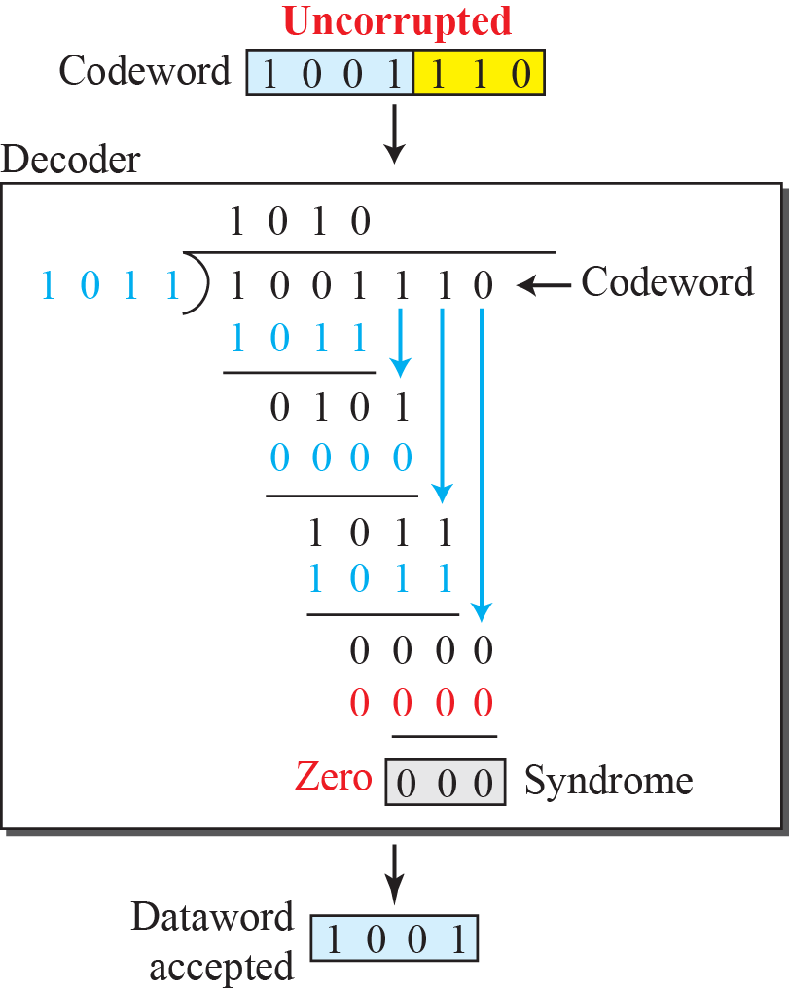
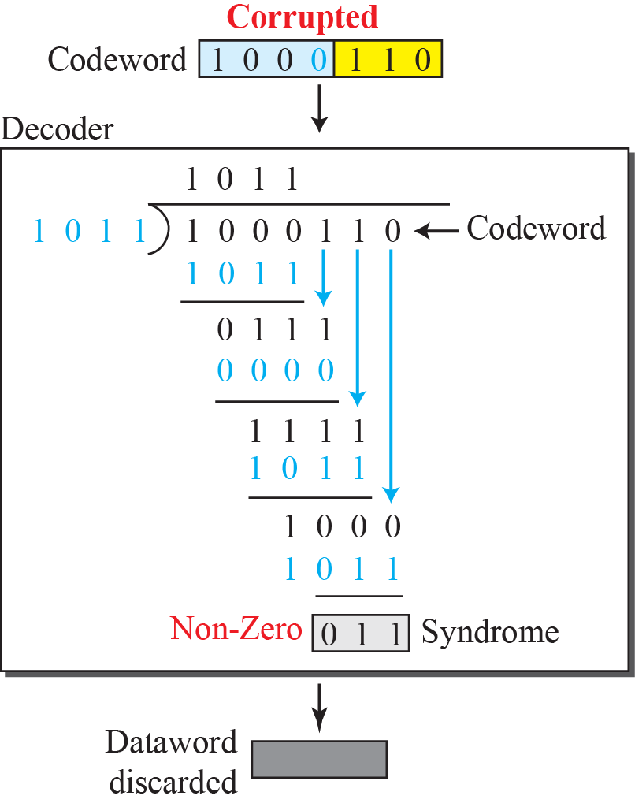
Division in the CRC decoder for two cases

Slide 58
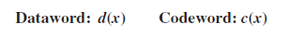
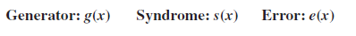
Performance
In a cyclic code, those e(x) errors that are divisible by g(x) are not caught.
If the generator has more than one term and the coefficient of x⁰ is 1, all single errors can be caught.
A generator that contains a factor of x + 1 can detect all odd-numbered errors.

Slide 59
Performance (contd.)
All burst errors with L ≤ r will be detected.
All burst errors with L = r + 1 will be detected with probability 1 – (1/2)^{r–1}.
All burst errors with L > r + 1 will be detected with probability 1 – (1/2)^{r}.

Slide 60
Example
Which of the following g(x) values guarantees that a single-bit error is caught? For each case, what is the error that cannot be caught?
a. x + 1 b. x³ c. 1
Solution
a. No x^{i} can be divisible by x + 1. in other words, x^{i} /(x + 1) always has a remainder. Any single-bit error can be caught.
b. If i is equal to or greater than 3, x^{i} is divisible by g(x). The remainder of x^{i} /x³ is zero. All single-bit errors in positions 1 to 3 are caught.
c. All values of i make x^{i} divisible by g(x). No single-bit error can be caught. This g(x) is useless.

Slide 61
Properties of Good Polynomials
A good polynomial generator needs to have the following characteristics:
It should have at least two terms.
The coefficient of the term x⁰ should be 1.
It should have the factor x + 1.

Slide 62
CRC: a good candidate for many networks
Based on standard polynomials:
Ex: Ethernet 32-bit CRC is defined by:
Computed with simple shift/XOR circuits
Stronger detection than checksums:
very good performance in detecting single-bit errors, double errors, an odd number of errors, and burst errors.
Not vulnerable to systematic errors

Slide 63
The Data Link Layer Chapter 3
Data Link Layer Design Issues
Error Detection and Correction
Elementary Data Link Protocols
Improving Efficiency
Data Link Protocols in Practice
Summary

Slide 64
Elementary Data Link Protocols
Assumptions underly the communication model
Three simplex link-layer protocols
Utopia: No Flow Control or Error Correction
Adding Flow Control: Stop-and-Wait
Adding Error Correction: Sequence Numbers and ARQ

Slide 65
Initial Simplifying Assumptions (1 of 2)
Independent processes
Physical, data link, and network layers are independent
Communicate by passing messages back and forth
Unidirectional communication
Machines use a reliable, connection-oriented service
Reliable machines and processes
Machines do not crash

Slide 66
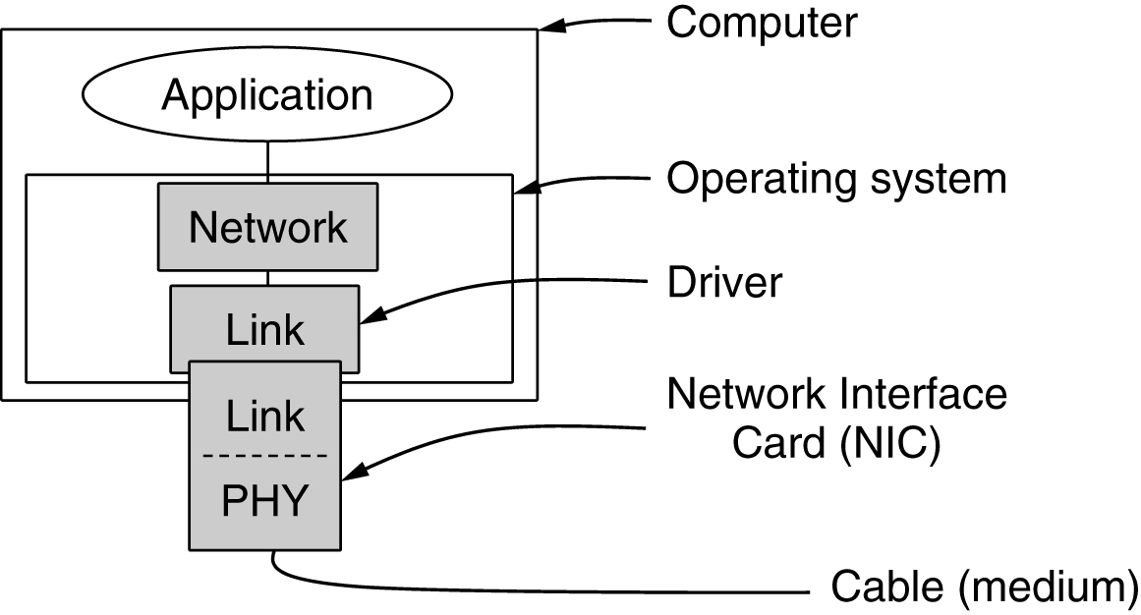
Initial Simplifying Assumptions (2 of 2)
The physical layer process and some of the data link layer process run on dedicate hardware called a NIC (Network Interface Card).
The rest of the link layer process and the network layer process run on the main CPU as part of the operating system, with the software for the link layer process often taking the form of a device driver.
However, other implementations are also possible (e.g., three processes offloaded to dedicated hardware called a network accelerator)
Implementation of the physical, data link, and network layers

Slide 67
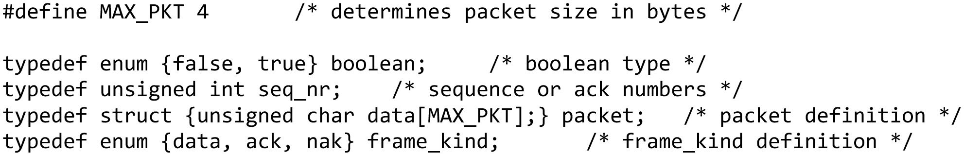
Basic Transmission And Receipt (1 of 6)
Some definitions needed in the protocols to follow. These definitions are located in the file protocol.h … continued on the next slide

Slide 68
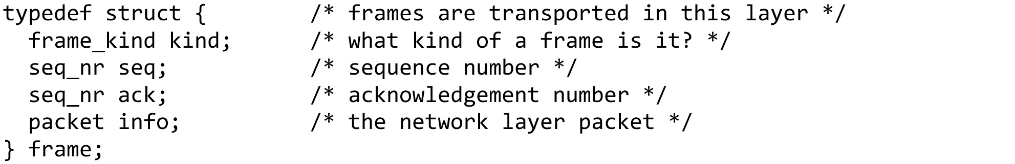
Basic Transmission And Receipt (2 of 6)
Some definitions needed in the protocols to follow. These definitions are located in the file protocol.h … continued on the next slide

Slide 69
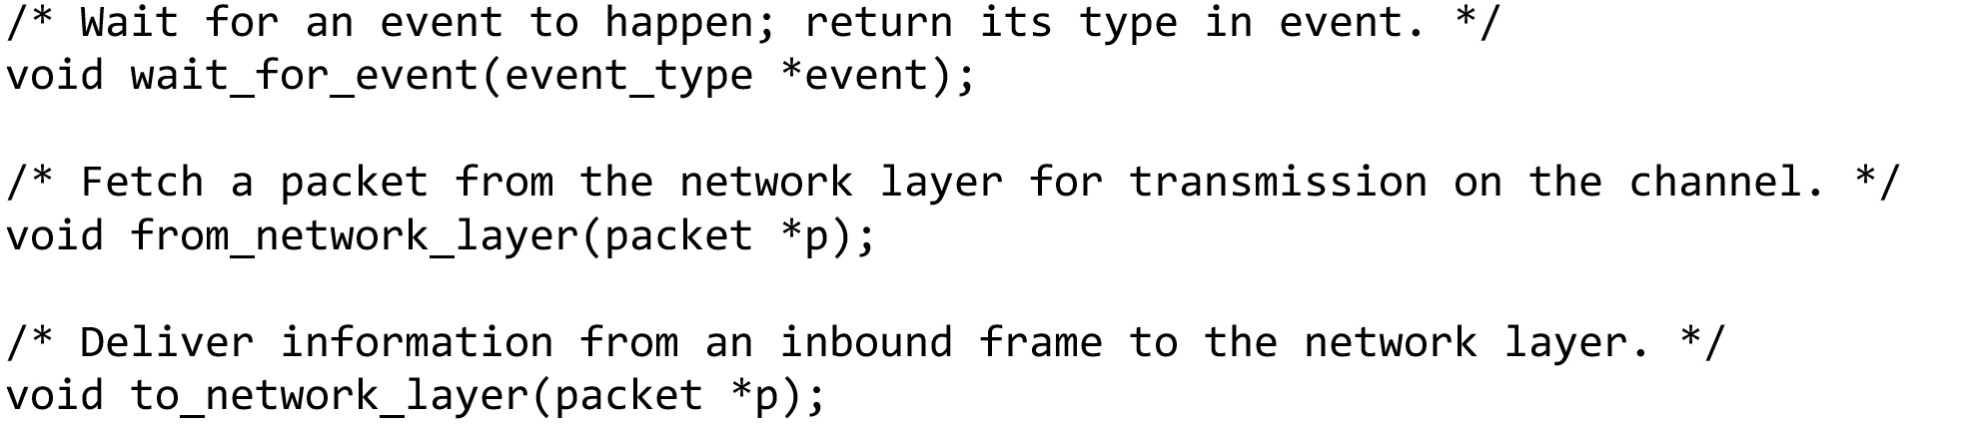
Basic Transmission And Receipt (3 of 6)
Some definitions needed in the protocols to follow. These definitions are located in the file protocol.h … continued on the next slide

Slide 70
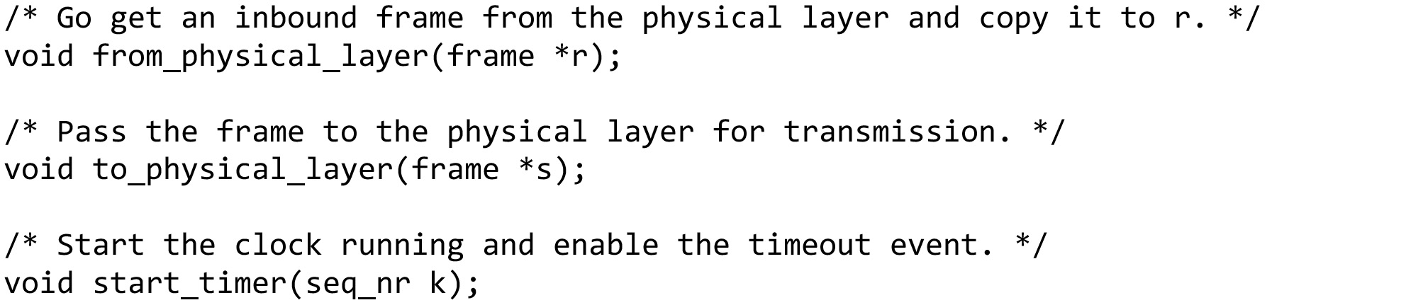
Basic Transmission And Receipt (4 of 6)
Some definitions needed in the protocols to follow. These definitions are located in the file protocol.h … continued on the next slide

Slide 71
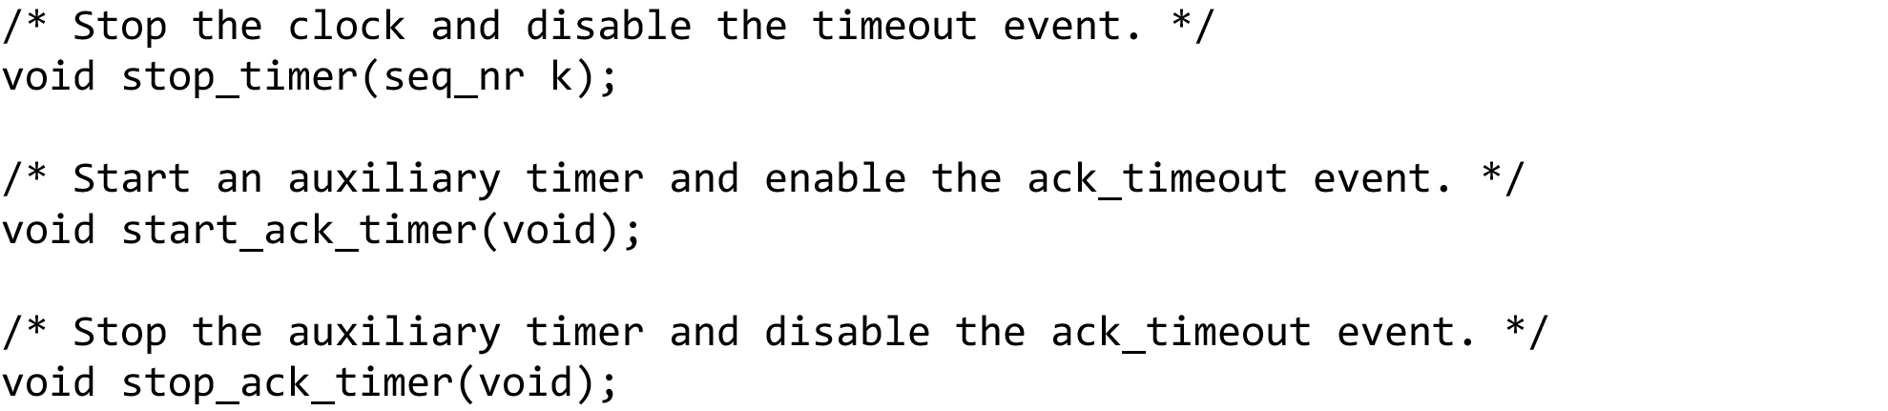
Basic Transmission And Receipt (5 of 6)
Some definitions needed in the protocols to follow. These definitions are located in the file protocol.h … continued on the next slide

Slide 72
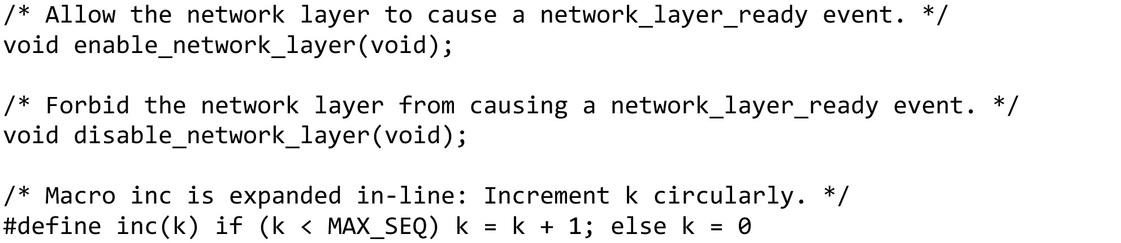
Basic Transmission And Receipt (6 of 6)
Some definitions needed in the protocols to follow. These definitions are located in the file protocol.h (end of code)

Slide 73
Simplex Link-Layer Protocols
Utopia: No Flow Control or Error Correction
Adding Flow Control: Stop-and-Wait
Adding Error Correction: Sequence Numbers and ARQ

Slide 74

Utopian Simplex Protocol (1)
Assumes no errors, and receiver as fast as sender
Considers one-way data transfer
That’s it, no error or flow control …
This is essentially what Ethernet does – just blast packets and receive as quickly as possible
A utopian simplex protocol … continued on the next slide

Slide 75

Utopian Simplex Protocol (2)
A utopian simplex protocol … continued on the next slide

Slide 76

Utopian Simplex Protocol (3)
A utopian simplex protocol (end of code)

Slide 77




Utopian Simplex Protocol (4)

Slide 78

Stop-and-Wait – Error-free channel (1)
Protocol (p2) ensures sender can’t outpace receiver:
Receiver returns a dummy frame (ack) when ready
Only one frame out at a time – called stop-and-wait
We added flow control!
A simplex stop-and-wait protocol … continued on the next slide

Slide 79

Stop-and-Wait – Error-free channel (2)
Sender waits to for ack after passing frame to physical layer.
A simplex stop-and-wait protocol … continued on the next slide

Slide 80

Stop-and-Wait – Error-free channel (3)
Receiver sends ack after passing frame to network layer.
A simplex stop-and-wait protocol (end of code)

Slide 81

Stop-and-Wait – Noisy channel (1)
ARQ (Automatic Repeat reQuest) adds error control
ARQ is also called PAR (Positive Acknowledgement with Retransmission)
Receiver acks frames that are correctly delivered
Sender sets timer and resends frame if no ack)
For correctness, frames and acks must be numbered
Else receiver can’t tell retransmission (due to lost ack or early timer) from new frame
For stop-and-wait, 2 numbers (1 bit) are sufficient
A positive acknowledgement with retransmission protocol … continued on the next slide

Slide 82

Stop-and-Wait – Noisy channel (2)
This is essentially what 802.11 does – stop-and-wait to handle wireless errors. 802.11 uses a larger sequence number (12 bits) and gives up after a limited number of retransmissions (retries).
A positive acknowledgement with retransmission protocol … continued on the next slide

Slide 83

Stop-and-Wait – Noisy channel (3)
A positive acknowledgement with retransmission protocol (end of code)

Slide 84

Stop-and-Wait – Noisy channel (4)
Sender sends frame with CRC, and sets timer,
Receiver verifies CRC value and sends ACK,
Sender sends a new frame when receives an ACK, sends old frame when timeout.

Slide 85



Stop-and-Wait – Noisy channel (5)
The 1st frame is sent and acknowledged.
The 2nd frame is sent, but lost. After time-out, it is resent.
The 3rd frame is sent and ACKed, but the ACK is lost. The frame is resent.
How to correct this problem?
Using sequence numbers and acknowledgment numbers.
Is there any problem here?
It is not right for the network layer at the receiver site receives two copies of the 3rd frame.

Slide 86




Stop-and-Wait – Noisy channel (6)
Adding sequence numbers and acknowledgment numbers to prevent duplicates.
The 1st frame is sent and acknowledged.
The 2nd frame is sent, but lost. After time-out, it is resent.
The 3rd frame is sent and ACKed, but the ACK is lost. The frame is resent.

Slide 87
The Data Link Layer Chapter 3
Data Link Layer Design Issues
Error Detection and Correction
Elementary Data Link Protocols
Improving Efficiency
Data Link Protocols in Practice
Summary

Slide 88
Improving Efficiency
Need bidirectional data transmission
Link layer efficiency improvement
Send multiple frames simultaneously before receiving an acknowledgement

Slide 89
Piggybacking
Bidirectional transmission: piggybacking
Use the same link for data in both directions
Interleave data and control frames on the same link
Temporarily delay outgoing acknowledgements so they can be hooked onto the next outgoing data frame
Piggybacking advantages
A better use of the available channel bandwidth
Lighter processing load at the receiver
Piggybacking issue
Determining time data link layer waits for a packet to piggyback the acknowledgement
Notes:
If the data link layer waits longer than the sender’s timeout period, the frame will be retransmitted.

Slide 90
Multiple Frames in Flight
Three bidirectional sliding window protocols
One-bit sliding window, go-back-n, selective repeat
Consider any instant of time
Sender maintains a set of sequence numbers corresponding to frames it is permitted to send. Frames are said to fall within the sending window
Receiver maintains a receiving window corresponding to the set of frames it is permitted to accept
Differ among themselves in terms of efficiency, complexity, and buffer requirements

Slide 91
Sliding Window Concept
Sending window
Sender maintains window of frames it can send
Needs to buffer them for possible retransmission
Window advances with next acknowledgements
Receiving window
Receiver maintains window of frames it can receive
Needs to keep buffer space for arrivals
Window advances with in-order arrivals

Slide 92




Sliding window in circular format
Window size: 7
Sequence number: 4-bit

Slide 93




Sliding window in linear format

Slide 94


Sliding Window Example
A sliding window advancing at the sender and receiver
Ex: window size is 1, with a 3-bit sequence number.
Sender
Receiver
At the start
After the first frame has been sent
After the first frame has been received
After the first acknowledgement has been received

Slide 95


Pipelining
Larger windows enable pipelining for efficient link use
Stop-and-wait (w=1) is inefficient for long links
Best window (w) depends on bandwidth-delay (BD)
Want w = 2BD+1 to ensure high link utilization
Notice: BD here is in the number of frames
If we use BDP directly, suppose L is the length of a frame, the formula should be w = 2BDP/L+1
Pipelining leads to different choices for errors/buffering
We will consider Go-Back-N and Selective Repeat
Sender
Receiver
F1
D
F2
F3
L/B
…
D
ACK
Fn
$$\frac{\frac{nL}{B}}{2D+\frac{L}{B}}≤1$$
Link utilization =
$$n ≤\frac{2BD}{L}+1$$
Notes:
Pipelining means that there are multiple frames outstanding in the network at any instant.
For stop-and-wait, imagine a link from Seattle to Amsterdam that has a 500ms round-trip time. It doesn’t matter how fast the link is in bits/sec, stop-and-wait will only let it run at two packets per second.

Slide 96


Link Utilization without Pipelining
Stop-and-wait with ACK piggybacking
Stop-and-wait
Sender
Receiver
Sender
Receiver
F1
D
F1
D
L/B
L/B
L/B
D
F with ACK
ACK
D
F2
F2
$$\frac{\frac{L}{B}}{2D+\frac{L}{B}}=\frac{1}{\frac{2BD}{L}+1}$$
$$\frac{\frac{L}{B}}{2D+\frac{2L}{B}}=\frac{1}{\frac{2BD}{L}+2}$$
Link utilization =
Link utilization =

Slide 97


Link Utilization with Pipelining
individual short ACK
ACK piggybacking
Sender
Receiver
Sender
Receiver
F1
D
F1
D
F2
F2
F3
L/B
F3
L/B
…
…
L/B
Fn
D
Fn
ACK
ACK
D
…
…
$$\frac{\frac{nL}{B}}{2D+\frac{L}{B}}=\frac{n}{\frac{2BD}{L}+1}$$
$$\frac{\frac{nL}{B}}{2D+\frac{2L}{B}}=\frac{n}{\frac{2BD}{L}+2}$$
Link utilization =
Link utilization =

Slide 98
Pipelining Example
E.g.: For a link with a bandwidth of 50kbps and a one-way transmit time of 250msec, the bandwidth-delay product is 12.5 kbits or 12.5 frames of 1000bits each.
2BD+1 = 2 * 12.5 + 1 = 26 frames
At t = 0 ms, the sender begins sending frame 0 and sends a new frame every 20 msec.
At t = 520 ms, it has finished sending 26 frames, and the acknowledgement for frame 0 will have just arrived.
Thereafter, acknowledgements will arrive every 20 msec, so the sender will always get permission to continue just when it needs it.
From then onwards, 25 or 26 unacknowledged frames will always be outstanding. Put in other terms, the sender’s maximum window size is 26.

Slide 99

One-Bit Sliding Window (1)
The sequence numbers are based on modulo-2 arithmetic.
Transfers data in both directions with stop-and-wait
Piggybacks acks on reverse data frames for efficiency
Handles transmission errors, flow control, early timers
Window size = 1
A 1-bit sliding window protocol … continued on the next slide

Slide 100

One-Bit Sliding Window (2)
A 1-bit sliding window protocol … continued on the next slide

Slide 101

One-Bit Sliding Window (3)
A 1-bit sliding window protocol (end of code)

Slide 102

One-Bit Sliding Window (4)
Normal
Abnormal
simultaneous start
duplicate transmissions
correct but slow
Two scenarios for protocol 4. (a) Normal case. (b) Abnormal case. The notation is (seq, ack, packet number). An asterisk indicates where a network layer accepts a packet.

Slide 103

Pipelining and error recovery
Go-Back-N
Selective Repeat
Effect of an error when (a) receiver’s window size is 1 and (b) receiver’s window size is large.

Slide 104
Go-Back-N
Receiver only accepts/acks frames that arrive in order
Discards frames that follow a missing/errored frame
Sender times out and resends all outstanding frames
Tradeoff made for Go-Back-N:
Simple strategy for receiver; needs only 1 frame
Wastes link bandwidth for errors with large windows; entire window is retransmitted
Receiver’s window size is always 1
Sender’s window must be less than 2^{m}
Cumulative Acknowledgment: Ack for frame n means n - 1, n - 2, and so on are also acknowledged.

Slide 105

Send window for Go-Back-N
The send window is an abstract concept defining an imaginary box of size 2^{m} − 1 with three variables: S_{f}, S_{n}, and S_{size}.
The send window can slide one or more slots when a valid acknowledgment arrives.

Slide 106

Receive window for Go-Back-N
The receive window is an abstract concept defining an imaginary box of size 1 with one single variable R_{n}.
The window slides when a correct frame has arrived; sliding occurs one slot at a time.

Slide 107

Send Window size for Go-Back-N

Slide 108


FSMs for Go-Back-N Protocol

Slide 109

Cumulative Acknowledgment
Although ACK 2 is lost, ACK 3 serves as both ACK 2 and ACK 3.

Slide 110

What happens when a frame is lost in Go-Back-N?
The receiver receives frames 2 and 3, but they are discarded because they are received out of order.
Notes:
Frames 0, 1, 2, and 3 are sent. However, frame 1 is lost. The receiver receives frames 2 and 3, but they are discarded because they are received out of order. The sender receives no acknowledgment about frames 1, 2, or 3. Its timer finally expires. The sender sends all outstanding frames (1, 2, and 3) because it does not know what is wrong. Note that the resending of frames 1, 2, and 3 is the response to one single event.

Slide 111

Simulation of multiple timers in software
(a) The queued timeouts. (b) The situation after the first timeout has expired.

Slide 112

Go-Back-N protocol (1)
A sliding window protocol using go-back-n … continued on the next slide

Slide 113

Go-Back-N protocol (2)
A sliding window protocol using go-back-n … continued on the next slide

Slide 114

Go-Back-N protocol (3)
A sliding window protocol using go-back-n … continued on the next slide

Slide 115

Go-Back-N protocol (4)
A sliding window protocol using go-back-n … continued on the next slide

Slide 116

Go-Back-N protocol (5)
A sliding window protocol using go-back-n … continued on the next slide

Slide 117

Go-Back-N protocol (6)
A sliding window protocol using go-back-n … continued on the next slide

Slide 118

Go-Back-N protocol (7)
A sliding window protocol using go-back-n (end of code)

Slide 119
Selective Repeat
Receiver accepts frames anywhere in receive window
Cumulative ack indicates highest in-order frame
NAK (negative ack), sent immediately when a error may happened, causes sender retransmission of a missing frame before a timeout resends window
The size of the sender and receiver window must be at most 2^{m-1}.
Tradeoff made for Selective Repeat:
More complex than Go-Back-N due to buffering at receiver and multiple timers at sender
More efficient use of link bandwidth as only lost frames are resent (with low error rates)

Slide 120


Send and receive window for Selective Repeat

Slide 121

Window size for Selective Repeat

Slide 122

Window size for Selective Repeat (cont.)
For correctness, we require:
Sequence numbers (s) at least twice the window (w)
Error case (s=8, w=7) – too few sequence numbers
Correct (s=8, w=4) – enough sequence numbers
Initial situation with a window of size 7
After 7 frames have been sent and received but not acknowledged.
Initial situation with a window size of 4.
After 4 frames have been sent and received but not acknowledged
Originals
Retransmits
Originals
Retransmits
New receive window overlaps old – retransmits ambiguous
New and old receive window don’t overlap – no ambiguity

Slide 123


FSMs for Selective Repeat Protocol

Slide 124

What happens when a frame is lost in Selective Repeat?
The timers need to be numbered.
A NAK is sent once for each window position and defines the first slot in the window.
Cumulative acknowledgment
distinguish between the acceptance of a frame and its delivery to the network layer.
Notes:
There are two conditions for the delivery of frames to the network layer:
First, a set of consecutive frames must have arrived.
Second, the set starts from the beginning of the window.

Slide 125

Selective Repeat Protocol (1)
A sliding window protocol using selective repeat … continued on the next slide

Slide 126

Selective Repeat Protocol (2)
A sliding window protocol using selective repeat … continued on the next slide

Slide 127

Selective Repeat Protocol (3)
A sliding window protocol using selective repeat … continued on the next slide

Slide 128

Selective Repeat Protocol (4)
A sliding window protocol using selective repeat … continued on the next slide

Slide 129

Selective Repeat Protocol (5)
A sliding window protocol using selective repeat … continued on the next slide

Slide 130

Selective Repeat Protocol (6)
A sliding window protocol using selective repeat (end of code)

Slide 131
Exercises
Assume a sender sends 6 frames: frames 0, 1, 2, 3, 4, and 5. The sender receives an ACK with ackNo = 3.
What is the interpretation if the system is using GBN or SR?
Solution
If the system is using GBN, it means that frames 0, 1, and 2 have been received uncorrupted and the receiver is expecting frame 3.
If the system is using SR, it means that frame 3 has been received uncorrupted; the ACK does not say anything about other frames.

Slide 132
The Data Link Layer Chapter 3
Data Link Layer Design Issues
Error Detection and Correction
Elementary Data Link Protocols
Improving Efficiency
Data Link Protocols in Practice
Summary

Slide 133
Data Link Protocols in Practice
HDLC (High-level Data Link Control )
Packet over SONET
ADSL (Asymmetric Digital Subscriber Loop)

Slide 134
HDLC
High-level Data Link Control (HDLC) is a bit-oriented protocol for communication over point-to-point and multipoint links.
Although HDLC is more a theoretical issue than practical, most of the concept defined in HDLC is the basis for other practical protocols such as PPP, Ethernet, or wireless LANs.
HDLC provides two common transfer modes that can be used in different configurations: normal response mode (NRM) and asynchronous balanced mode (ABM).

Slide 135




Normal Response Mode (NRM)
In NRM, the station configuration is unbalanced.
We have one primary station and multiple secondary stations.
A primary station can send commands; a secondary station can only respond.
The NRM is used for both point-to-point and multipoint links

Slide 136



Asynchronous Balanced Mode
In ABM, the configuration is balanced.
The link is point-to-point, and each station can function as a primary and a secondary (acting as peers),

Slide 137




HDLC Frames
HDLC defines three types of frames:
information frames (I-frames): to transport data-link user data and control information relating to user data (piggybacking)
supervisory frames (S-frames): to transport control information
unnumbered frames (U-frames): reserved for system management
HDLC Frame formats and their control fields
Flag: 01111110

Slide 138








Example of connection and disconnection
SABM: set asynchronous balanced mode
UA: unnumbered acknowledgment
DISC: disconnect
Notes:
how U-frames can be used for connection establishment and connection release.
Node A asks for a connection with a set asynchronous balanced mode (SABM) frame; node B gives a positive response with an unnumbered acknowledgment (UA) frame. After these two exchanges, data can be transferred between the two nodes (not shown in the figure). After data transfer, node A sends a DISC (disconnect) frame to release the connection; it is confirmed by node B responding with a UA (unnumbered acknowledgment).

Slide 139


Example of piggybacking with and without error
REJ: Reject
RR: Receive ready

Slide 140

Packet over SONET
Packet over SONET is the method used to carry IP packets over SONET optical fiber links
Uses PPP (Point-to-Point Protocol) for framing
Packet over SONET. (a) A protocol stack. (b) Frame relationships.

Slide 141

Point-to-Point Protocol
PPP (Point-to-Point Protocol) is a general method for delivering packets across links
Framing uses a flag (0x7E) and byte stuffing
“Unnumbered mode” (connectionless unacknowledged service) is used to carry IP packets
Errors are detected with a checksum
Separate packets, error detection
Link Control Protocol (LCP)
Network Control Protocol (NCP)
The PPP full frame format for unnumbered mode operation
0x21 for IPv4
IP packet

Slide 142
Differences between PPP and HDLC
Framing
PPP is byte oriented. PPP uses byte stuffing and all frames are an integral number of bytes.
HDLC is bit oriented. HDLC uses bit stuffing and allows frames of, for example, 30.25 bytes.
Services
PPP always use an ‘‘unnumbered mode’’ to provide connectionless unacknowledged service used in the Internet. PPP can also provide reliable transmission in noisy environments, such as wireless networks (rare in practice).
HDLC provides reliable transmission with a sliding window, acknowledgements, and timeouts in the manner we have studied.

Slide 143

State machine for link control in PPP
A link control protocol brings the PPP link up/down
State machine for link control

Slide 144


Multiplexing in PPP
Although PPP is a link-layer protocol, it uses another set of protocols to establish the link, authenticate the parties involved, and carry the network-layer data.
Three sets of protocols are defined to make PPP powerful: the Link Control Protocol (LCP), two Authentication Protocols (APs), and several Network Control Protocols (NCPs).
PAP（Password Authentication Protocol）
CHAP（Challenge Handshake Authentication Protocol）

Slide 145



LCP packet encapsulated in a frame

Slide 146


PAP packets encapsulated in a PPP frame

Slide 147


CHAP packets encapsulated in a PPP frame

Slide 148


IPCP packet encapsulated in a PPP frame
IPCP: Internet Protocol Control Protocol

Slide 149

An example of PPP

Slide 150

ADSL (1 of 2)
Widely used for broadband Internet over local loops
ADSL runs from modem (customer) to DSLAM (ISP)
IP packets are sent over PPP and AAL5/ATM (over)
ADSL protocol stacks

Slide 151

ADSL (2 of 2)
PPP data is sent in AAL5 frames over ATM cells:
ATM is a link layer that uses short, fixed-size cells (53 bytes); each cell has a virtual circuit identifier
AAL5 is a format to send packets over ATM
PPP frame is converted to a AAL5 frame (PPPoA)
AAL5 frame is divided into 48 byte pieces, each of which goes into one ATM cell with 5 header bytes
Notes:
Re ATM: ATM was a major technology in the 1990s that was hyped to win in the convergence of the Internet and telecommunications, but IP won instead. The short, fixed-size cells give flexibility (can mix voice and data without having the voice wait for a whole data packet). ATM is now used in niches such as ADSL and WAN links.

Slide 152

Data Over Cable Service Interface Specification (DOCSIS)
DOCSIS Frame to codeword mapping

Slide 153
The Data Link Layer Chapter 3
Data Link Layer Design Issues
Error Detection and Correction
Elementary Data Link Protocols
Improving Efficiency
Data Link Protocols in Practice
Summary

Slide 154
Summary (1 of 4)
The task of the data link layer is
to convert the raw bit stream offered by the physical layer into a stream of frames for use by the network layer. Various framing methods are used, including byte count, byte stuffing, and bit stuffing.
to present this stream with varying levels of reliability: connectionless, unacknowledged service to reliable, connection-oriented service.
Data link protocols can provide
error control to detect or correct damaged frames and to retransmit lost frames.
flow control to prevent a fast sender from overrunning a slow receiver.
The sliding window mechanism is widely used to integrate error control and flow control in a simple way. When the window size is 1 packet, the protocol is stop-and-wait.

Slide 155
Summary (2 of 4)
Codes for error correction and detection add redundant information to messages by using a variety of mathematical techniques.
Convolutional codes and Reed-Solomon codes are widely deployed for error correction, with low-density parity check codes increasing in popularity.
The codes for error detection that are used in practice include cyclic redundancy checks and checksums.
All these codes can be applied at the link layer, as well as at the physical layer and higher layers.

Slide 156
Summary (3 of 4)
A series of protocols that provide a reliable link layer using acknowledgements and retransmissions, or ARQ (Automatic Repeat reQuest), under more realistic assumptions.
an error-free environment in which the receiver can handle any frame sent to it,
we introduced flow control, followed by error control with sequence numbers and the stop-and-wait algorithm.
Then we used the sliding window algorithm to allow bidirectional communication and introduce the concept of piggybacking.
The last two protocols pipeline the transmission of multiple frames to prevent the sender from blocking on a link with a long propagation delay.
The receiver can either discard all frames other than the next one in sequence (go-back-n), or buffer out-of-order frames and send negative acknowledgements for greater bandwidth efficiency (selective repeat ).

Slide 157
Summary (4 of 4)
The Internet uses PPP as the main data link protocol over point-to-point lines.
It provides a connectionless unacknowledged service, using flag bytes to delimit frames and a CRC for error detection.
It is used to carry packets across a range of links, including SONET links in wide area networks and ADSL links for the home.
DOCSIS is used when Internet service is provided over the existing cable TV network.

Slide 158

Copyright
This work is protected by United States copyright laws and is provided solely for the use of instructors in teaching their courses and assessing student learning. Dissemination or sale of any part of this work (including on the World Wide Web) will destroy the integrity of the work and is not permitted. The work and materials from it should never be made available to students except by instructors using the accompanying text in their classes. All recipients of this work are expected to abide by these restrictions and to honor the intended pedagogical purposes and the needs of other instructors who rely on these materials.

